Slide 1








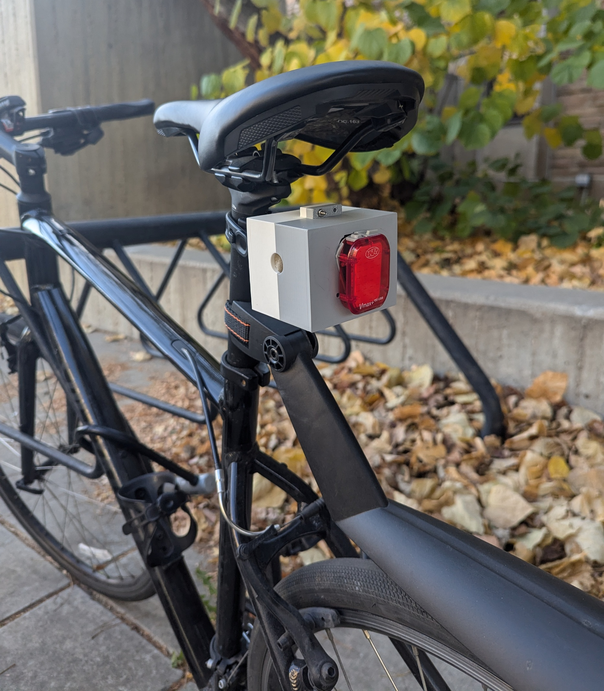
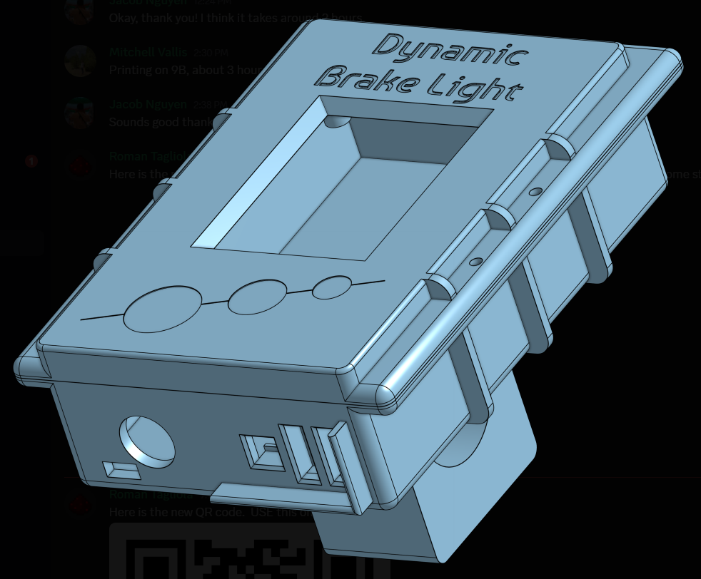
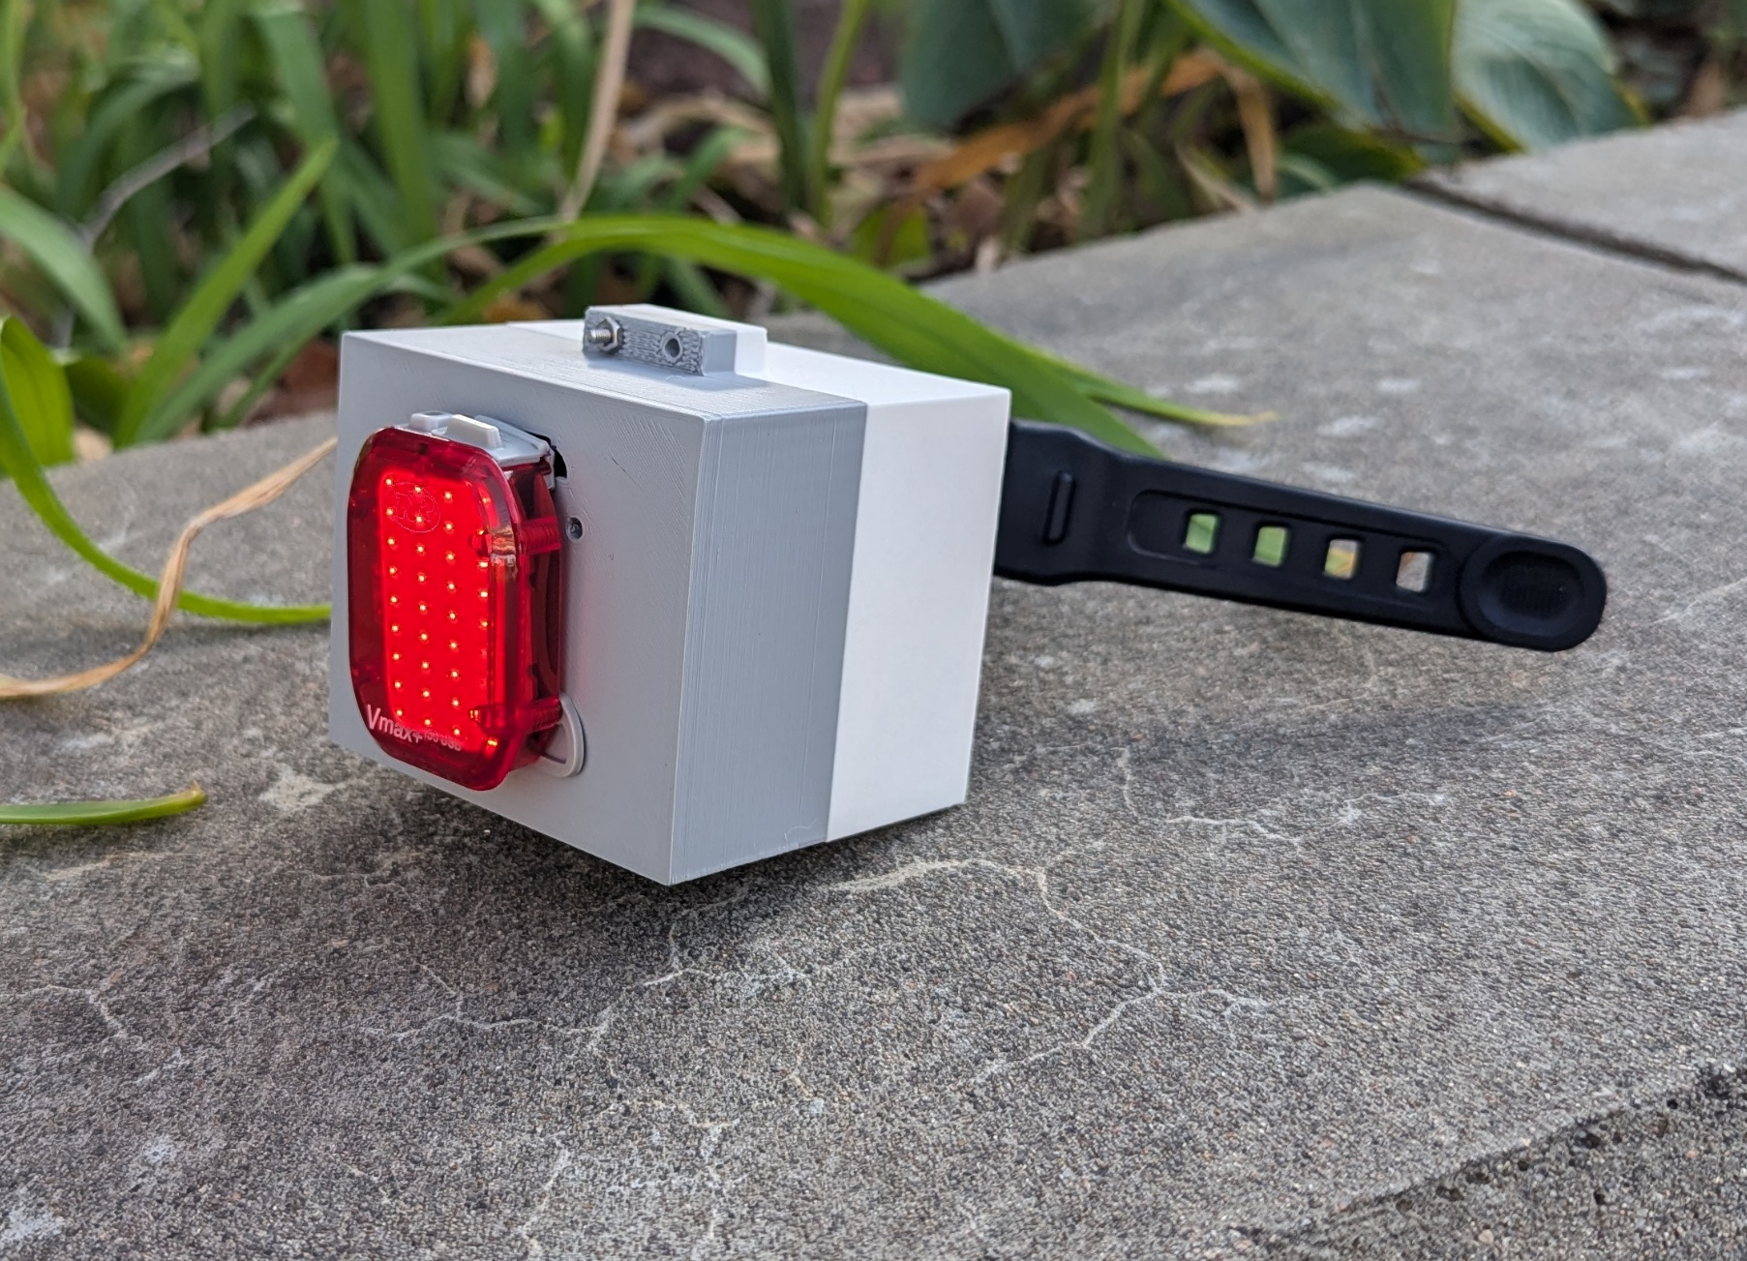
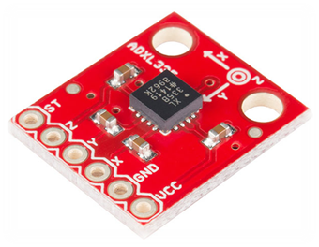
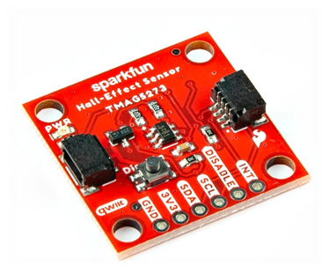
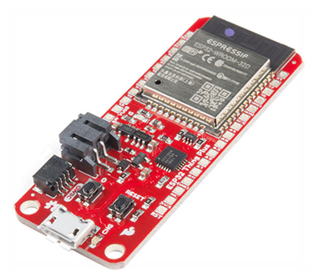
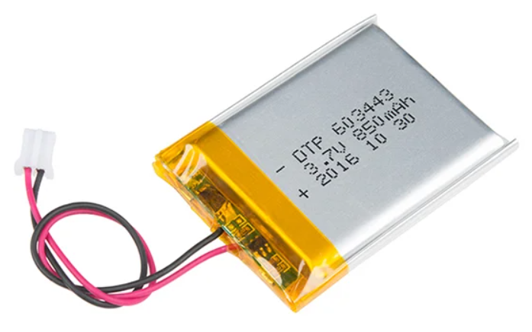
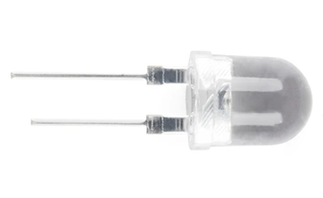
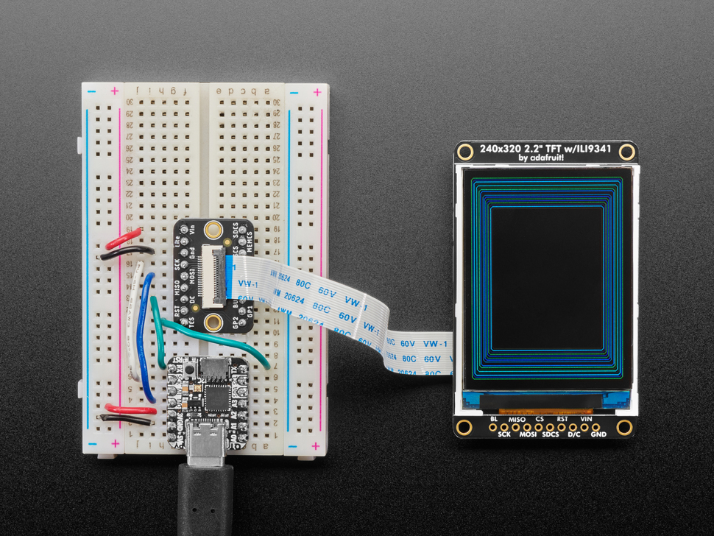
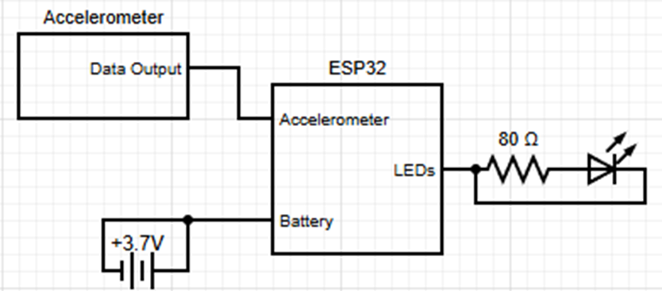
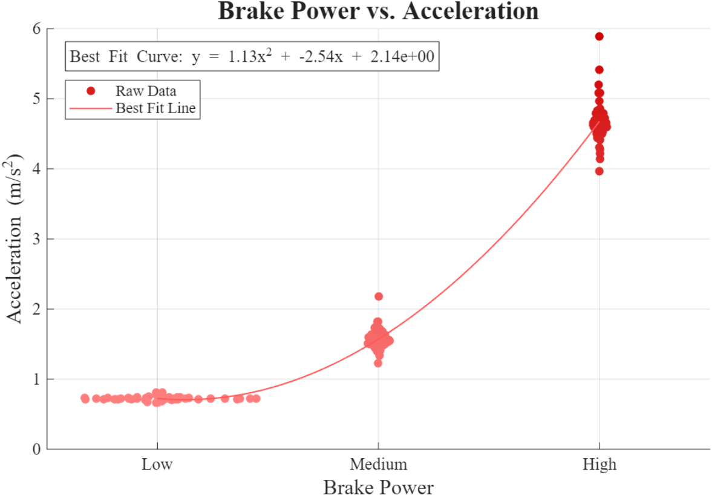
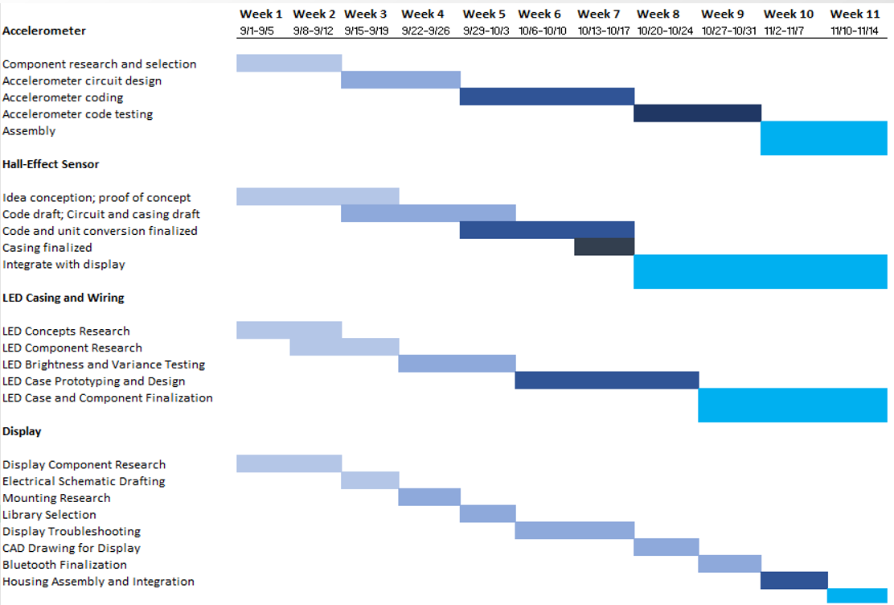
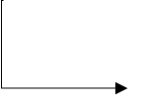
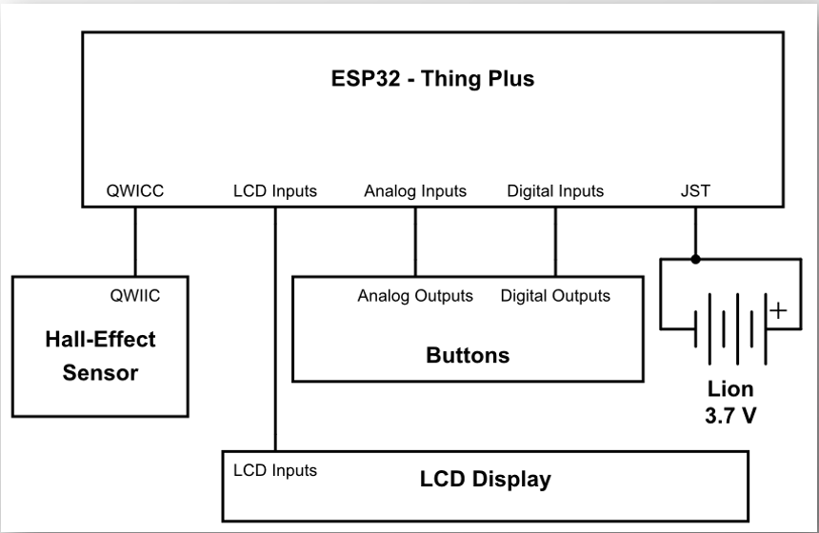
Check out our GitHub!
Dynamic Brake Light
By The Light Brakers
ECEN 1400 Fall 2025
Inspiration
Bikes generally don’t have a brake light indicating when the cyclist is braking Congested bike lanes can reduce the rider’s reaction time, leading to crashes
Team Members
Future Addons
Auto-Charging Implement auto-charging, where the peddling of the bike charges the brake light Upgraded Display Add more customizable options to the display module
Rowan McCune
Electrical Engineering
Jacob Nguyen
Electrical Engineering
Mitchell Vallis
Electrical Engineering
Roman Tagliola
Aerospace Engineering
Project Goals
Design and develop an original idea that can improve safety in the biking community
Brake Light
Display Module
Challenges
Non-functioning devices Learning new software/hardware Short development time
Components
Bill of Materials
Accelerometer
ADXL335
Linear 3D
Hall-Effect Sensor
TMAG5273
Component | Price (USD)
Triple Axis Accelerometer Breakout | $20
Linear 3D Hall-Effect Sensor | $7
LED – Super Bright Red (25 Pack) | $5
Qwiic Cable Kit | $13
Capacitor Kit | $12
Color TFT LCD | $25
Thing Plus – ESP32 WROOM | $25 x2
Total | $132
ESP32 Thing Plus
How it works:
The Dynamic Brake Light increases in brightness the quicker you are slowing down
How it works:
The Display Module takes kinematic inputs and displays them on the screen
Lithium Ion Battery, 850 mAh
Block Diagrams
Testing
Red LED
(10000mcd)
Brake Light
LCD TFT Display
Software Flow Chart
Gantt Chart
Hall-Effect Sensor
Accelerometer
Data collection
Display Module
Data collection
Controller
Controller
Process Data
Data
User Interface and Kinematic Computations
Braked at low, medium and high braking power
Used braking data to quantify voltage reading the accelerometer gives
LED Array
LCD Display
Light Output
User Configured
Information
Acknowledgements
We would like to thank our TA Liza Gunther, and our professors Tim Swettlen, Rylee Beach, and Kevin Hallquist

